Slide 1

INSIGHTIQ
An AI-Powered Text Analysis Platform
Welcome to the presentation of INSIGHTIQ, a cutting-edge platform designed to transform raw textual data into actionable intelligence using advanced AI and Natural Language Processing techniques.
Presenter Details:
Name: Rama Sudhamshu Kumar

Slide 2

The Challenge:
Large volumes of text are difficult to analyze manually, making the process time-consuming and inefficient—and there's no single unified platform for extracting all insights.
There is a critical need for a unified, intelligent system that efficiently converts raw, unstructured text into meaningful and actionable insights.

Slide 3
OUR AIM
INSIGHTIQ: Transforming Text into Knowledge
1
AI-Powered Platform Development
To engineer a robust AI-based platform specifically tailored for comprehensive text analysis.
2
Advanced Sentiment Analysis
To accurately determine the emotional tone within text, categorizing it as positive or negative.
3
Intelligent Summarization
To generate both extractive (key sentences) and abstractive (rephrased) summaries for quick comprehension.
4
Hidden Topic Discovery
To uncover latent topics and themes that are not immediately obvious within large datasets of text.
5
Intuitive Visual Outputs
To present analytical results through clear, interpretable visualizations on a user-friendly dashboard.
6
Seamless User Experience
To ensure an intuitive and accessible web interface, making advanced text analysis available to all users.

Slide 4






Technology Stack & Development Tools
The development of INSIGHTIQ relied on a modern and robust technology stack, incorporating leading tools for efficient development, deployment, and version control.
Python
Streamlit
The primary programming language, offering extensive libraries for AI and NLP.
Used for building the user-friendly and interactive web interface (UI) of INSIGHTIQ.
Scikit-learn
Hugging Face Transformers
A fundamental machine learning library, integral for model implementation and evaluation.
Provides state-of-the-art pre-trained models, crucial for abstractive summarization.
Matplotlib & WordCloud
GitHub
Libraries used for generating insightful visualizations, such as plots and word clouds.
Utilized for collaborative development, version control, and maintaining code integrity.

Slide 5

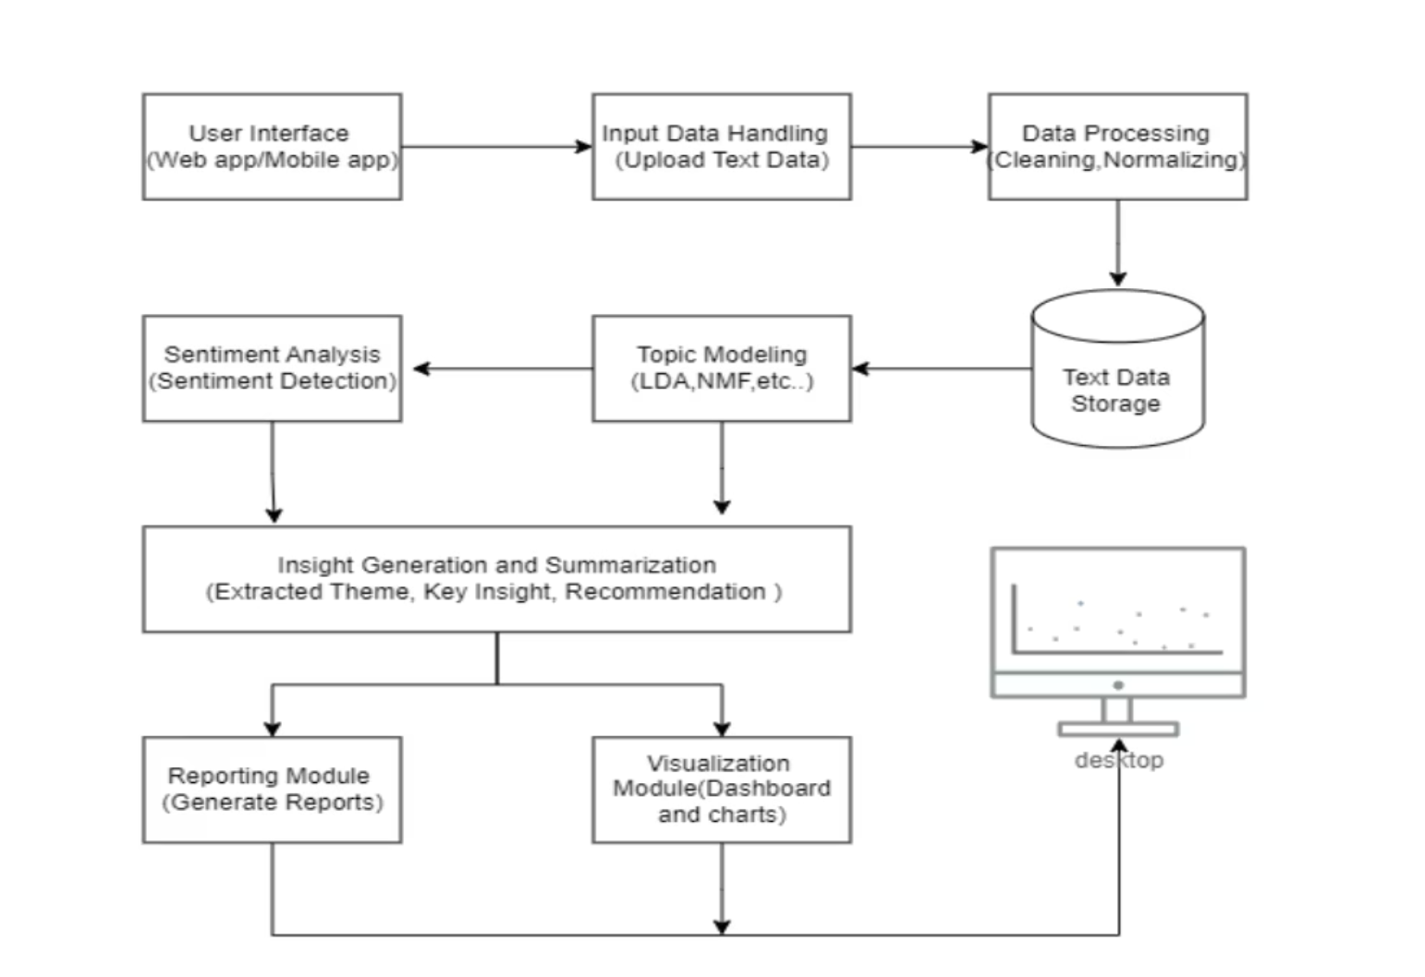
INSIGHTIQ: System Architecture Overview
INSIGHTIQ follows an end-to-end Natural Language Processing (NLP) pipeline, transforming raw text into actionable insights through a series of interconnected stages.
INSIGHTIQ processes text through a clear pipeline. It starts with raw text input, which undergoes crucial preprocessing like cleaning and tokenization. Next, core NLP models analyze sentiment, summarize content, and uncover hidden topics. Finally, all insights are presented as intuitive visual outputs on a user-friendly dashboard.

Slide 6
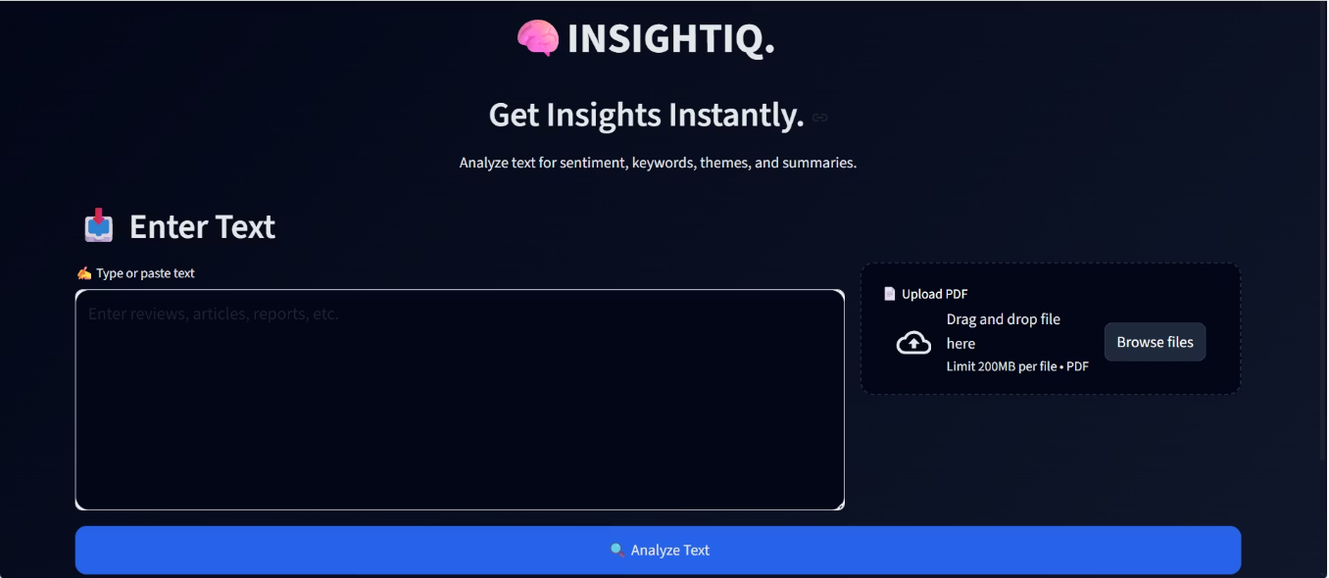
TECHNICAL FOUNDATION
Input Data & Essential Preprocessing
Versatile Input Handling
Rigorous Preprocessing Steps
INSIGHTIQ is designed to accept various forms of textual input, ensuring flexibility for diverse user needs.
To ensure optimal performance and accuracy of our NLP models, all input text undergoes a series of meticulous preprocessing stages.
Text Documents: Direct input of raw text for immediate analysis.
Cleaning & Normalization: Removal of noise, special characters, and conversion to a consistent format.
PDF Files: Capability to process and extract text from Portable Document Format files, a common format for academic and business documents.
Tokenization: Breaking down text into individual words or phrases (tokens) for analysis.
Stopword Removal: Eliminating common, less informative words (e.g., "the," "a," "is") to focus on significant content.
TF-IDF Vectorization: Transforming text into numerical representations that reflect the importance of words within a document relative to a corpus.

Slide 7
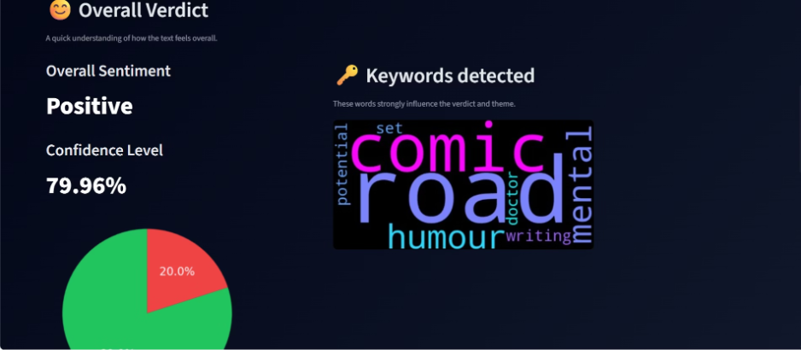
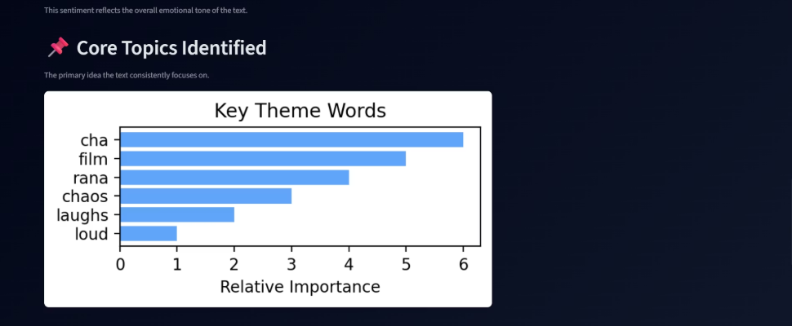
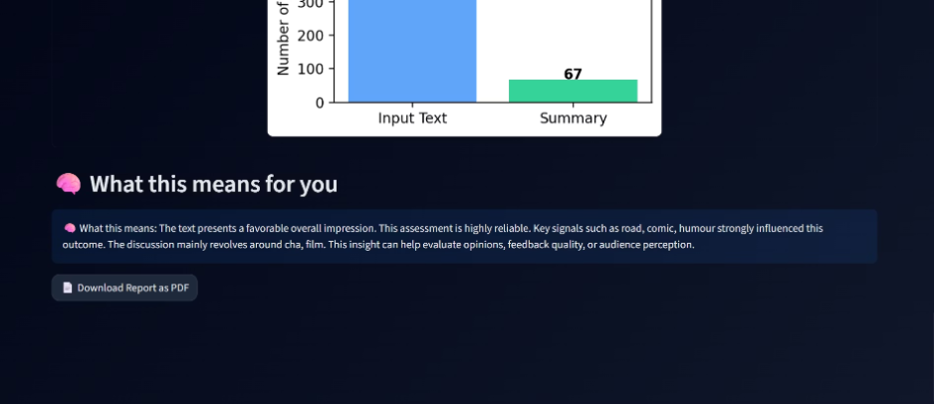
Core Models Employed in INSIGHTIQ
INSIGHTIQ leverages a selection of industry-standard NLP models, each chosen for its effectiveness in specific analytical tasks.
Sentiment Analysis
Text Summarization
Topic Modeling
Model: Logistic Regression
Extractive Model: TF-IDF
Model: NMF (Non-Negative Matrix Factorization)
Output: Categorizes text sentiment into Positive, Negative, or Neutral, providing a quick gauge of emotional tone.
Abstractive Model: T5-Small Transformer
Function: Identifies underlying themes and topics present within a collection of documents.
Offers both keyword-based summaries and contextually rephrased condensations of text.

Slide 8




STRATEGIC DECISIONS
Justification for Model Selection
The choice of models for INSIGHTIQ was driven by a commitment to balancing robust performance with practical considerations for efficiency and interpretability.
Logistic Regression
TF-IDF
Selected for its speed and high interpretability, allowing for quick and transparent sentiment classification.
An efficient and effective method for determining keyword importance in extractive summarization.
T5-Small Transformer
NMF (Non-Negative Matrix Factorization)
Utilized for its advanced capabilities in abstractive summarization, benefiting from pre-trained knowledge and lower computational cost compared to larger models.
Chosen for its effectiveness in separating and identifying distinct topics within textual data, yielding clear topic clusters.
INSIGHTIQ meticulously balances performance, simplicity, and computational efficiency to deliver superior text analysis.

Slide 9
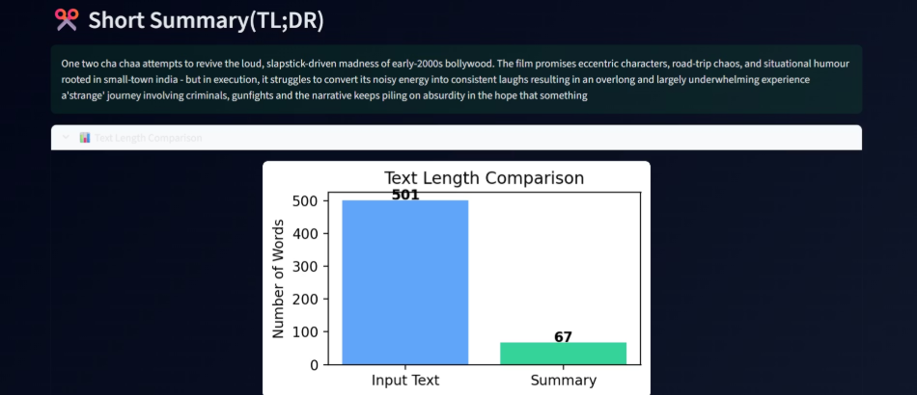

INSIGHTIQ in Action: Results & Outputs
Real-time, User-Friendly Insights
INSIGHTIQ is engineered to deliver analytical results instantaneously, ensuring that users receive timely feedback. The output interface is meticulously designed for clarity and ease of interpretation.
Sentiment Prediction: A clear indicator of the overall emotional tone.
Generated Summary: Concise overviews, both extractive and abstractive, for rapid understanding.
Topic Keywords: Highlights the most relevant keywords associated with identified themes.
Visualizations: Dynamic word clouds and interactive plots for an engaging data exploration experience.
All outputs are generated in real-time, with results that are consistently clear and user-friendly, fostering efficient decision-making.
INSIGHTIQ delivers immediate and digestible insights, transforming complex text into actionable intelligence.

Slide 10
Applications, Advantages & Future Vision
Broad-Ranging Applications
Key Advantages of INSIGHTIQ
Student Document Analysis: Rapidly grasp key points from research papers, essays, and textbooks.
Time-Efficient: Drastically reduces the time spent on manual text analysis.
Easy to Use: An intuitive interface makes advanced NLP accessible to non-technical users.
Movie Review Analysis: Extract sentiment and themes from reviews to enhance services.
Unified Insights: Consolidates multiple NLP analyses into a single, comprehensive platform.
News & Article Summarization: Quickly digest vast amounts of news content and stay informed.
Scalable Architecture: Built to handle increasing volumes of data and diverse analytical demands.
Research Paper Overview: Efficiently identify core arguments and findings in academic literature.

Slide 11
Future Scope & Enhancements
Multilingual Support: Expanding analysis capabilities to various languages.
Emotion Detection: Integrating more nuanced emotional analysis beyond basic sentiment.
Larger Transformer Models: Leveraging more powerful models for enhanced accuracy and depth.
Cloud Deployment: Ensuring broader accessibility and robust performance through cloud infrastructure.
INSIGHTIQ demonstrates the real-world application of AI and NLP concepts, with significant potential for future growth and impact.

Slide 12
THANK YOU

